Slide 1
What Traits Do You Have?

Slide 2
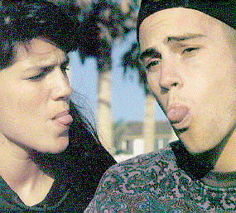
Tongue rolling: Extend your tongue and attempt to roll it into a U-shape longitudinally. People with this ability have the dominant allele for this trait. Use T for the dominant allele, and t for recessive allele (see figure).
Tongue-Rolling: Rolling up edges (dominant trait) vs not rolling (recessive)

Slide 3
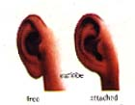
Attached earlobes: Have your lab partner examine your earlobes. If no portion of the lobe hangs free inferior to its point of attachment to the head, you are homozygous recessive (ee) for attached earlobes. If part of the lobe hangs free below the point of attachment, you possess at least one dominant gene (E) (see figure).

Slide 4
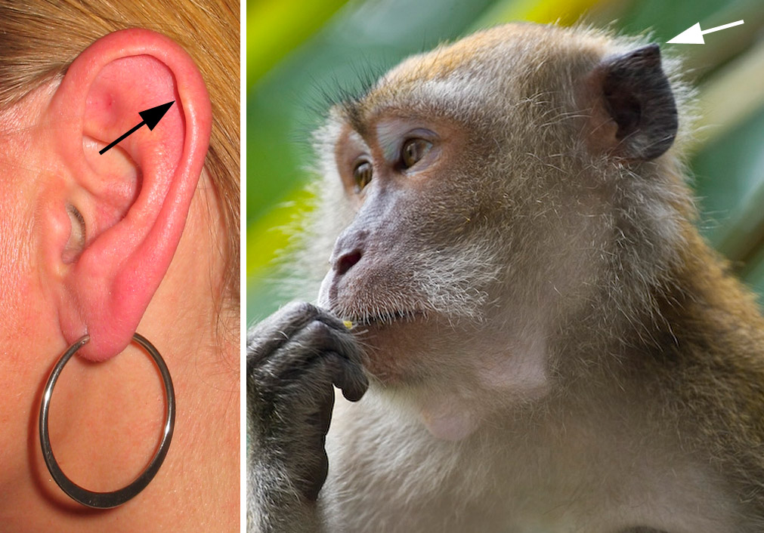
Darwin's tubercle is a congenital ear condition which often presents as a thickening on the helix at the junction of the upper and middle thirds. The feature is present in approximately 10.4% of the population.

Slide 5
Hitchhiker’s Thumb

Slide 6
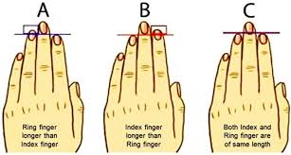
Relative finger length
Which is the longest finger on your hand besides your middle finger?

Slide 7
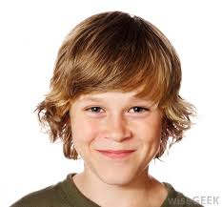
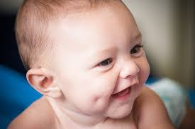
Dimpled cheeks: The presence of dimples in one or both cheeks is due to a dominant gene (D). Absence of dimples indicates the homozygous recessive condition (dd)

Slide 8
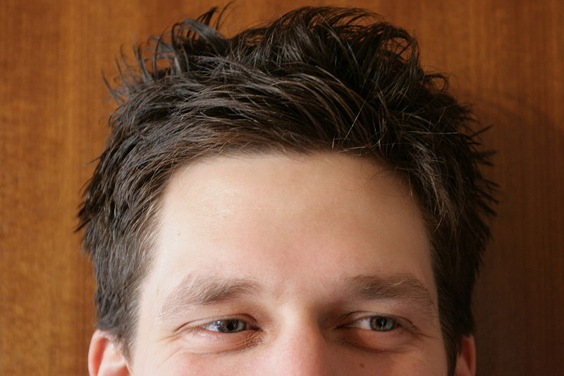
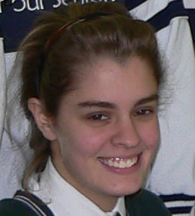
A widow's peak is a distinct point in the hairline in the center of the forehead.

Slide 9
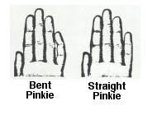
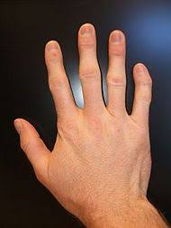
Bent little finger: Examine your little finger on each hand. If its terminal phalanx angles toward the ring finger, you are dominant for this trait. If one or both terminal digits are essentially straight, you are homozygous recessive for the trait. Use L for the dominant allele and l for the recessive allele.

Slide 10
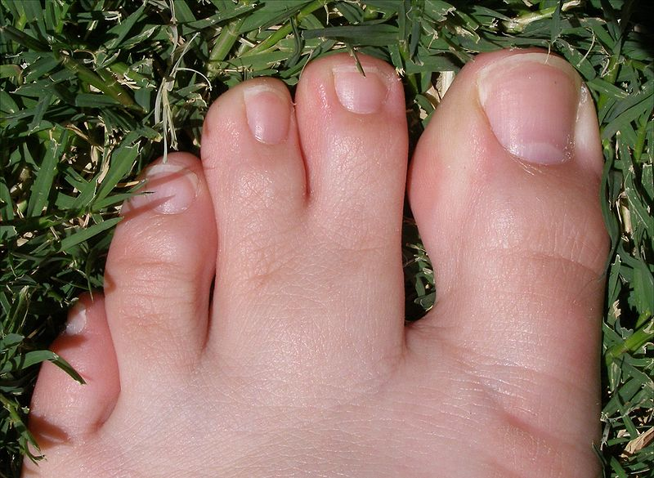
Webbing
Webbed toes is the common name for syndactyly affecting the feet. It is characterised by the fusion of two or more digits of the feet. In humans it is considered unusual, occurring in approximately one in 2,000 to 2,500 live births.
There are various levels of webbing, from partial to complete. Most commonly the second and third toes are webbed or joined by skin and flexible tissue. This can reach either part way up or nearly all the way up the toe.

Slide 11
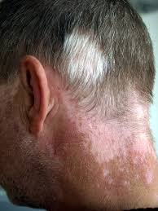
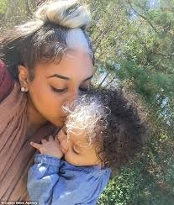
Blaze: A lock of hair different in color from the rest of the scalp hair is called a blaze; it is determined by a dominant gene. Use B for the dominant gene and b for the recessive gene.

Slide 12
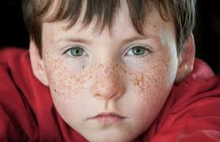
Freckles: The appearance of freckles is a result of a dominant gene. Use F as the dominant allele and f as the recessive allele (see figure).

Slide 13
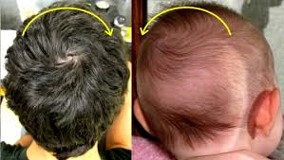
Whirl (which way your hair spins) -clockwise or counter-clockwise
People with long hair may not be able to find this since your hair is too heavy.

Slide 14
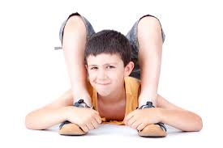
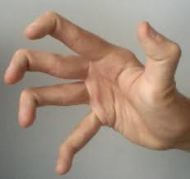
Double-jointed thumb: A dominant gene determines a condition of loose ligaments that allows one to throw the thumb out of joint. The homozygous recessive condition determines tight joints. Use J for the dominant allele and j for the recessive allele.

Slide 15
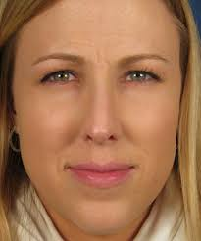
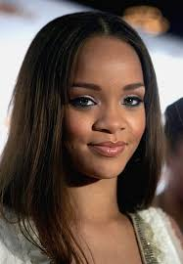
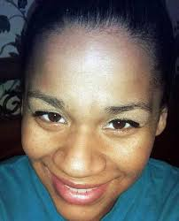
Nose – Broad(wide) or narrow

Slide 16
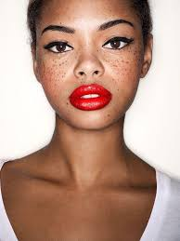
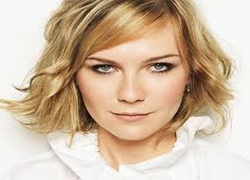
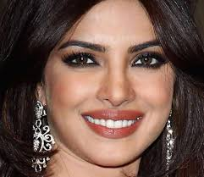
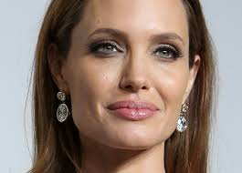
Lips Thin Thick

Slide 17
A, B, AB, and O,
Blood type: Inheritance of ABO blood type is based on the existence of 3 alleles designated as IA, IB, and i. Both IA and IB are dominant over i, but neither is dominant over each other. Thus the possession of IA, and IB will yield type AB blood, whereas the possession of the IA and i alleles will yield A blood, and so on as explained in Exercise 29. There are four ABO blood groups or phenotypes, A, B, AB, and O, and their correlation to genotype is indicated as follows:

Slide 18
Longest Toe

Slide 19
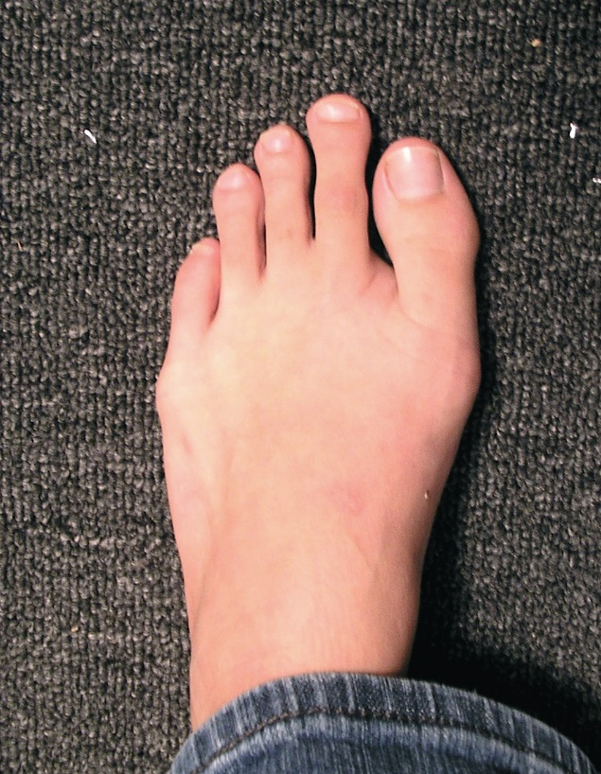
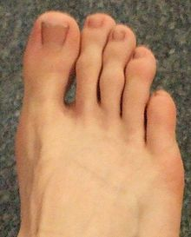
Morton's toe ( or Morton's syndrome[1], long toe) is the common term for the condition of a shortened first metatarsal in relation to the second metatarsal.

Slide 20
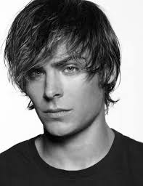
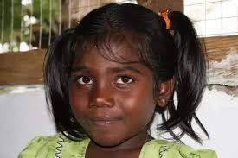
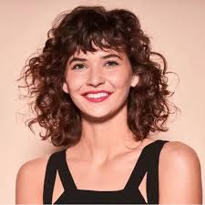
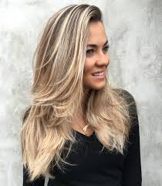
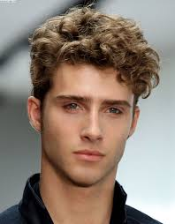
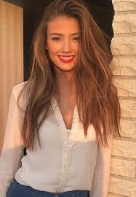
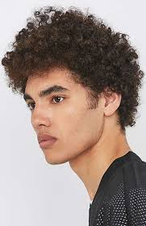
Hair Naturally Straight or Naturally Curly

Slide 21
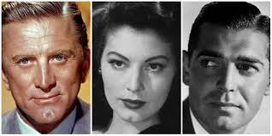
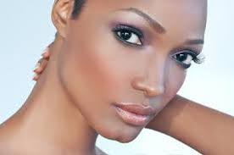
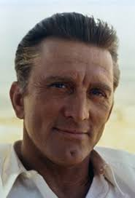
Dimple in Chin

Slide 22
Interlocking Thumbs- which is on top (right or left)?

Slide 23
Interlocking fingers: Clasp your hands together by interlocking your fingers. Now observe your clasped hands. Which thumb is uppermost? If the left thumb is uppermost, you possess a dominant allele (I) for this trait. If you clasped your right over your left thumb, you are illustrating the homozygous recessive (ii) phenotype.

