Slide 1
Mitosis/Meiosis Review

Slide 2
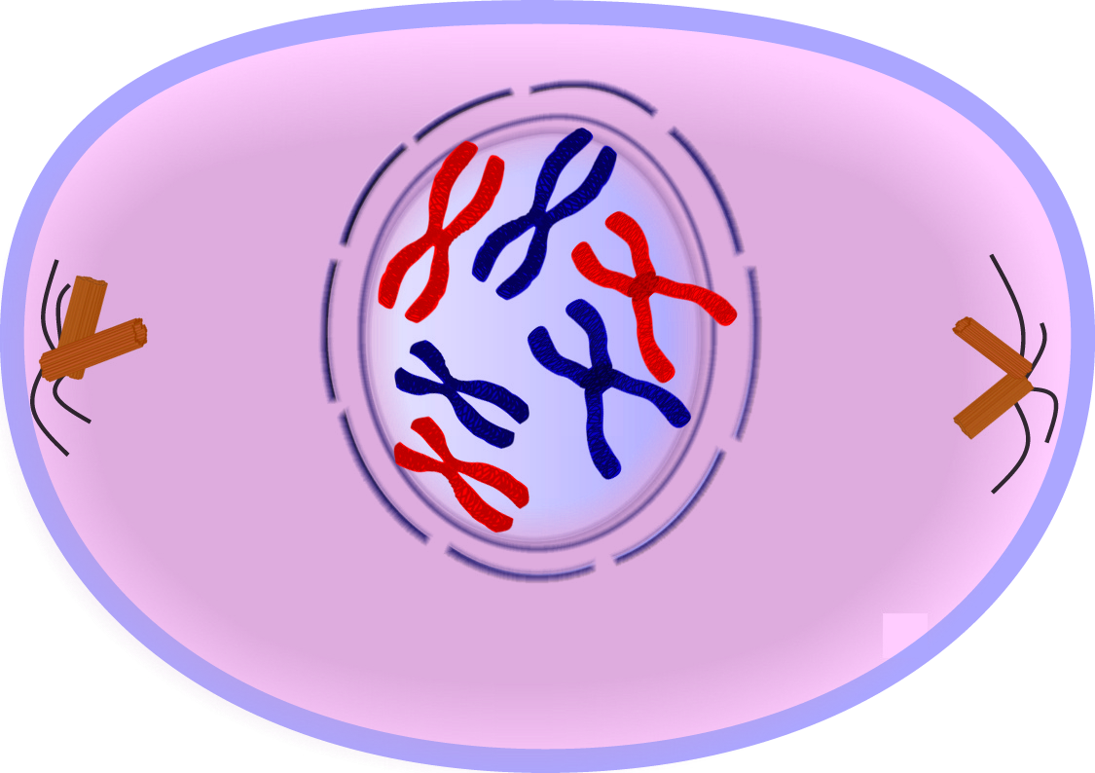
Label the following pictures

Slide 3
prophase

Slide 4
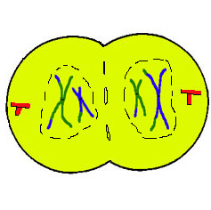

Slide 5
telophase

Slide 6
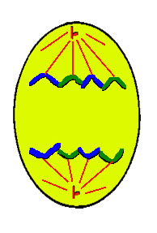

Slide 7
anaphase

Slide 8
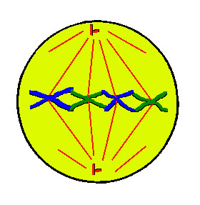

Slide 9
metaphase

Slide 10
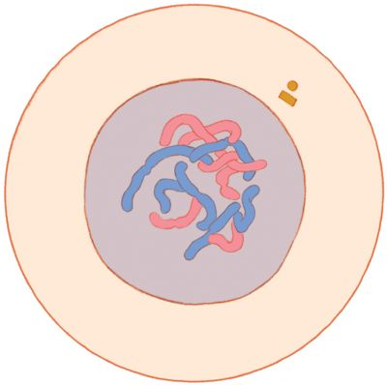

Slide 11
interphase

Slide 12
List the stages of mitosis in order.

Slide 13
Interphase
Prophase
Metaphase
Anaphase
Telophase

Slide 14
Identify what phase of mitosis is being described.
Chromosomes separate to opposite ends.
Chromosomes have doubled and the nuclear membrane is fading.
Cytophasm starts to divide into two cells.

Slide 15
Anaphase
Prophase
telophase

Slide 16
Identify what phase of mitosis is being described.
4. Cell is growing and daily activities occur.
5. Chromosomes line up in the center of the cell.

Slide 17
4. Interphase
5. metaphase

Slide 18
The total number of cells in an organism increases as a result of
Photosysthesis
Cell division
Fermentation
respiration

Slide 19
Cell division

Slide 20
The formation of a cell plate is a characteristic of _________
Cytokinesis in plant cells
Cytokinesis in animal cells
Both a and b
Neither a or b

Slide 21
Neither a or b
What phase is it???
It is TELEPHASE

Slide 22
TRUE OR FALSE
Cell divisions allow organisms to grow, repair damages structures, and produce energy.

Slide 23
FALSE
GROW, REPAIR AND REPRODUCE

Slide 24
TRUE OR FALSE
Mitosis results in the formation of two daughter cells.

Slide 25
TRUE

Slide 26
TRUE OR FALSE
The process in which the cell makes an exact copy of the DNA in its nucleus is replication.

Slide 27
TRUE

Slide 28
TRUE OR FALSE
Cell growth and production of new organelles and enzymes are characteristics of prophase.

Slide 29
FALSE
Interphase

Slide 30
TRUE OR FALSE
Body cells of humans have 46 pairs of chromosomes.

Slide 31
FALSE
23 pairs!

Slide 32
TRUE OR FALSE
Sex cells have twice the number of chromosomes as body cells.

Slide 33
FALSE
Sex cells have HALF the number of cells that a body cell has.

Slide 34
TRUE OR FALSE
Genes pass from parents to offspring on chromosomes.

Slide 35
TRUE

Slide 36
TRUE OR FALSE
The two chromosomes in a pair having the same genes lined up in the same order, with the exception of the male sex chromosome.

Slide 37
TRUE

Slide 38
TRUE OR FALSE
A fertilized egg has twice the number of chromosomes as the body cells of the parent.

Slide 39
FALSE

Slide 40
Which stage of the cell cycle usually lasts the longest?

Slide 41
interphase

Slide 42
mitosis or meiosis
The process that produces sex cells is?

Slide 43
meiosis

Slide 44
Tell how plant mitosis is different than animal mitosis

Slide 45
1. Plant cell has a cell plate 2. Plant cell divides from inside out and an animal cell divides from outside in.

